Slide 1
Section 4 – Active Directory & Identity Management
Centralized authentication
Organized users and System OUs
Enforced security using Group Policy

Slide 2
Active Directory Implementation Steps
Installing and configuring AS DS, DNS, and DHCP as the core domain services.
Create the domain environment, including OU structure, user/group organization
Creating 10 user accounts and join two client systems to the domain
Implementation of GPOs
Verifying functionality

Slide 3
Domain Controller (Google Cloud VM)
Hosted on Google Cloud VM
Promoted to Domain Controller
Installed AD DS and DNS
DHCP handled by Google Cloud networking

Slide 4
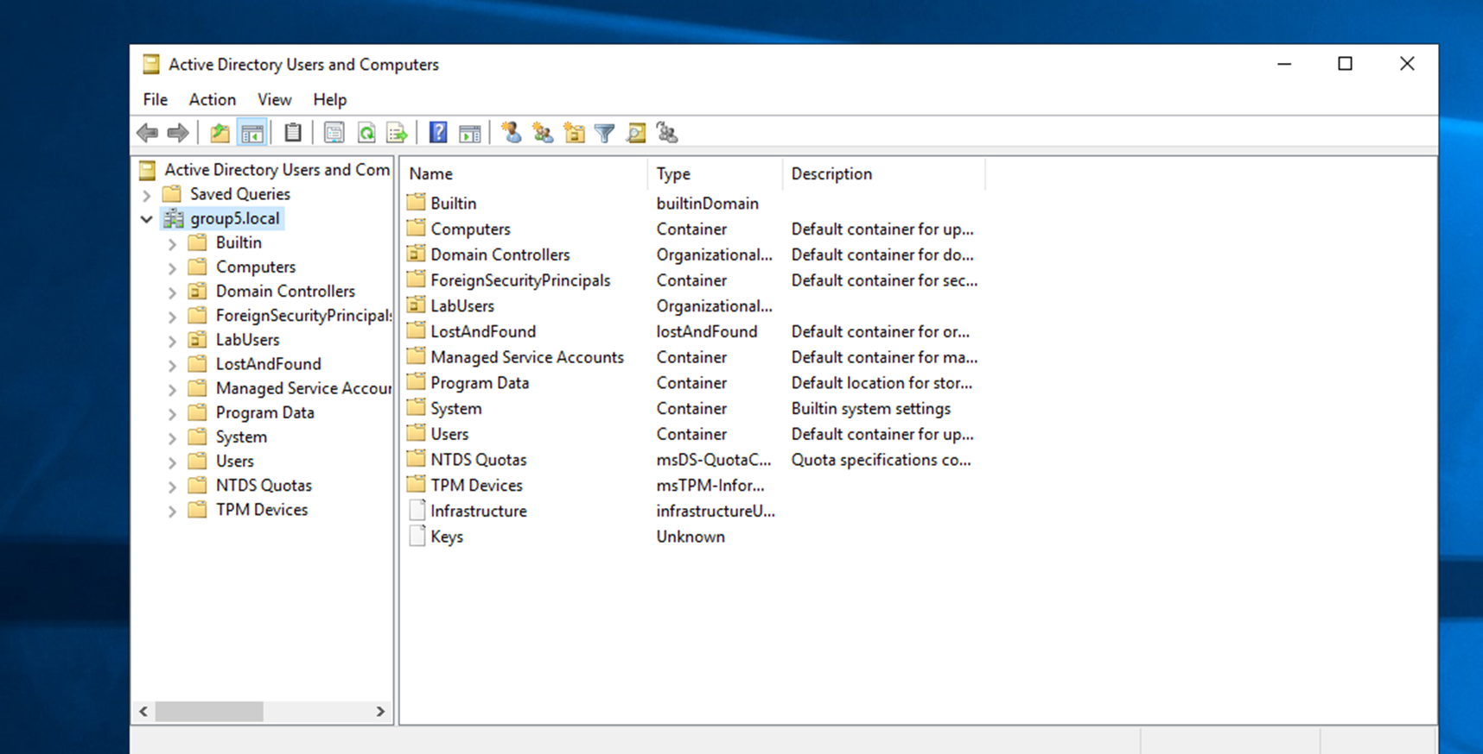
Domain Structure
Organized users and systems using OUs
Enabled targeted policy application
Improved management and access control

Slide 5
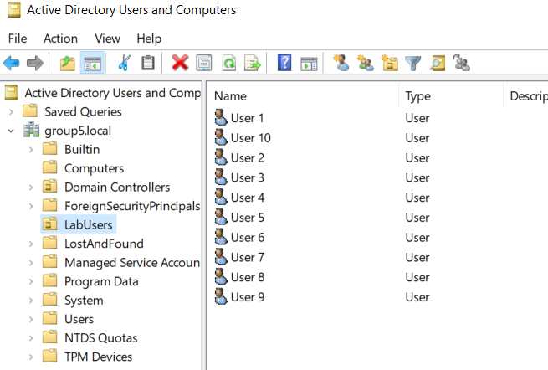
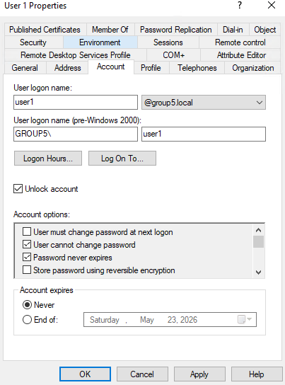
Active Directory Users and Computers
Created and organized user accounts within the domain (LabUsers OU)
Centralized user management through Active Directory
Supports authentication and access control across systems

Slide 6
Group Policy Baseline (GPOs)
Goal
Domain-level Group Policy implementation
Enforce security controls
Key Policies:
Password Policy PR.AA-01
Account Lockout Policy PR.AA-01
Audit Policy PR.PS-04

Slide 7
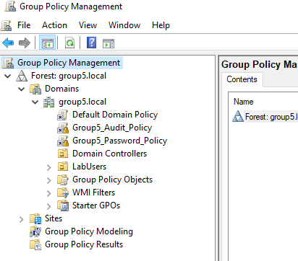
Group Policy Management
Created and linked Password & Audit GPOs at the domain level
Policies applied centrally to all domain users and systems
Ensures consistent security enforcement across the environment

Slide 8
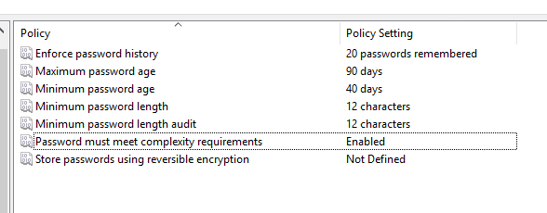
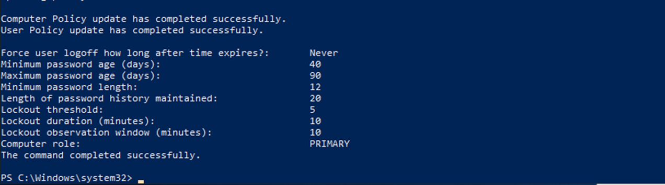
Password and Lockout Policy
Verified domain password & lockout policies using net accounts
Enforced minimum password length and complexity requirements
Configured account lockout threshold to prevent brute-force attacks
Applied domain-level policy through Group Policy (GPO)
Verification of policies using gpupdate /force, gpresult /r, net accounts

Slide 9
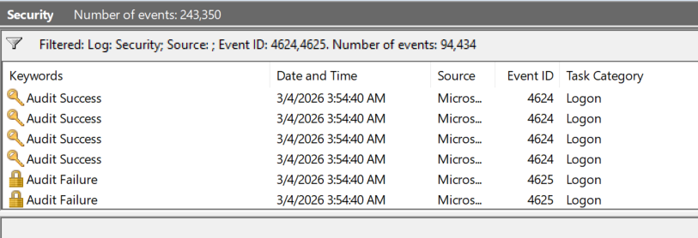
Audit policy
Enabled audit logging for login activity
Captures successful and failed authentication attempts
Verified using Event Viewer logs

Slide 10
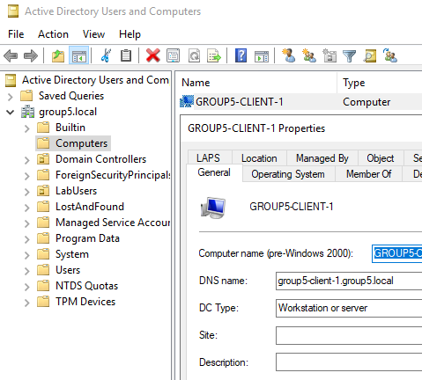
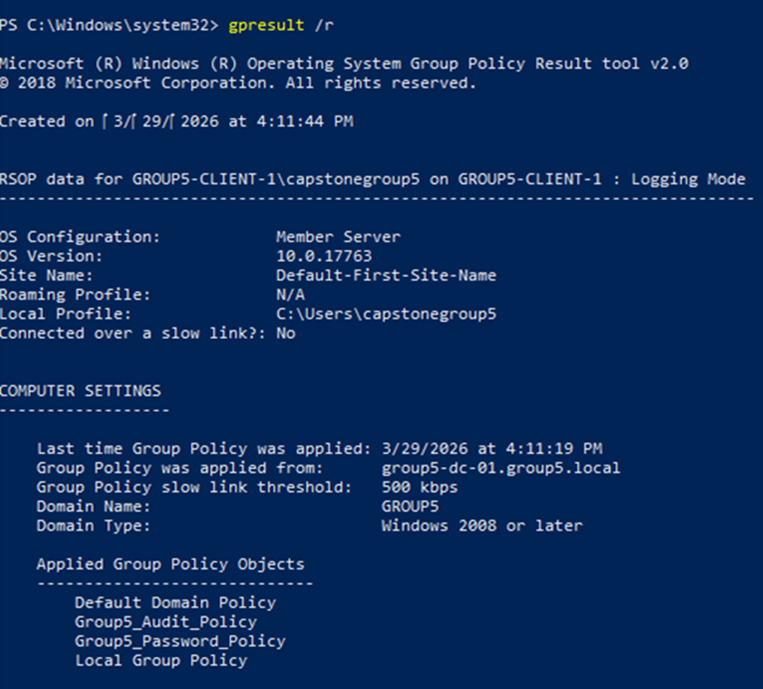
Client Virtual Machines

Slide 11
Section 5 - Automation & Compliance
Python Script
Rebuild & Preparedness
Compliance

Slide 12
Automation Example: Python Script Summary
ad_gpo_backup.py
Function
Copies the GPOs from an Active Directory Domain Controller and saves them in a ZIP file inside a specified GCP Bucket.
Requirements
Download the following:
Python 3.8 (minimum; newer version preferable)
Python packages pywinrm, google-cloud-compute, google-cloud-storage, google-auth
GCP service account key

Slide 13
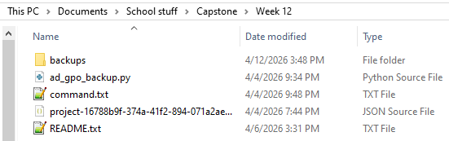
Python Script Example Setup
← Run "cmd" from here
← Logs go here automatically
← The script
← Command with options already filled
← GCP service account key
← File explaining how everything works

Slide 14
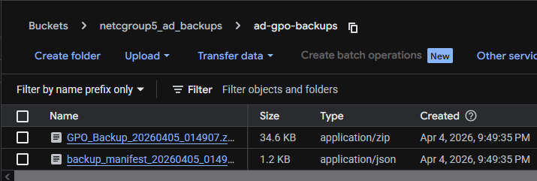
Usage
Open Command Prompt (cmd.exe)
Set your VM’s WinRM password as an environment variable
Run the script through Command Prompt, filling out each option with the necessary info and credentials
The GPO backups should now be in the GCP bucket
To reinstate the GPOs in AD, simply download & extract the backup on the DC, import it into PowerShell, and run the Restore-GPO command.

Slide 15
Rebuilds & Preparedness
We have done practice rebuilds of every part of our network:
Physical connections
Layer 2
Layer 3
Servers
Firewall
Practice rebuilds were all timed and logged, creating data and documentation that are useful for both quality control and future reference if necessary.
Our rebuild experience and backups would allow us to quickly restore operation in the case of an emergency.

Slide 16
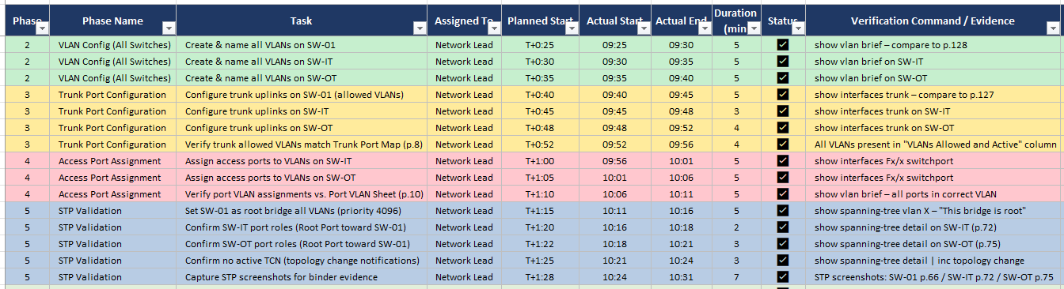
L2 & L3 Rebuild
This is a snippet of the timed layers 2 & 3 rebuild log.
The rest of the log is similarly detailed and timed just as accurately.
The final time for layers 2 & 3 rebuild completion was: 156 minutes

Slide 17
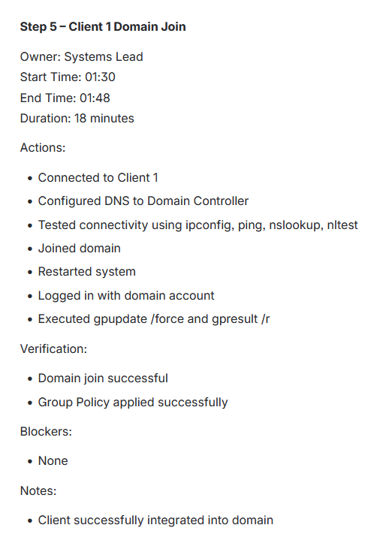
Server Rebuild
This is a snippet of the timed server rebuild log.
The rest of the log is similarly detailed and timed just as accurately.
The final time for server rebuild completion was:
133 minutes

Slide 18
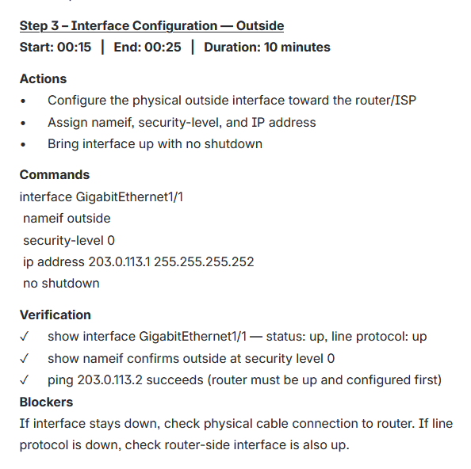
Firewall Rebuild
This is a snippet of the timed firewall rebuild log.
The rest of the log is even more detailed and extensive.
The final time for firewall rebuild completion was:
90 minutes

Slide 19
NIST CSF Preparedness Controls
We have full compliance with several NIST CSF controls. Our top ones are:
PR.AA-01 – Managed credentials (Already mentioned)
PR.PS-05 – Unauthorized software
ID.AM-01 – Hardware inventory
ID.AM-02 – Software inventory
The script and rebuilds are progress towards additional controls:
PR.DS-11 – Backups
ID.IM-04 – Incident response
RC.RP-01 – Recovery plan

Slide 20
Thank you.

